Slide 1

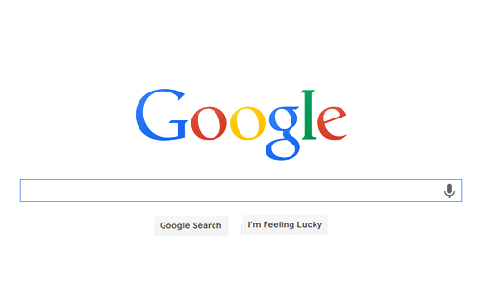

Google SEO
CHƯƠNG TRÌNH ĐÀO TẠO NHÂN VIÊN
Trình bày: Vũ Quang Sơn
HANOI – NOV, 2015

Slide 2

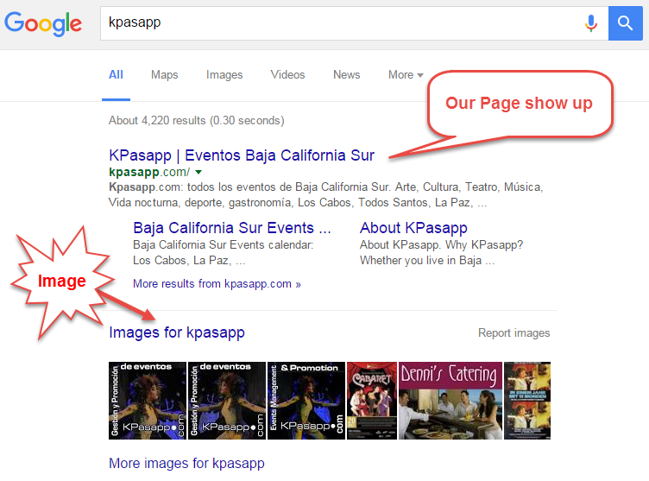
What’s
Search Engine Optimization (SEO)
Effort to increase rank in SERP

Slide 3
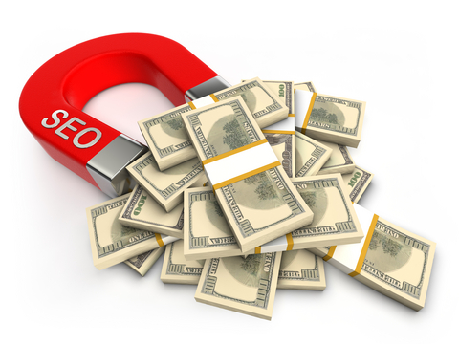


Why SEO matter?

Slide 4
SEO, how?
Meta tag
Open Graph, Twitter Card
Schema.org, Structured data
Part I
Optimize images
Optimize images

Slide 5
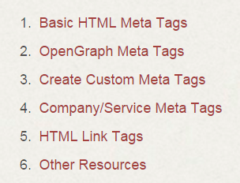
What’s Meta tag?
Texts tell SE about web content
Don’t appear on page, only in code (<head>)
Several kinds
Complete list of meta tags

Slide 6
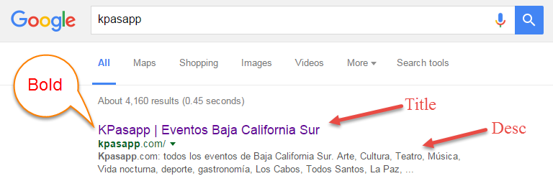
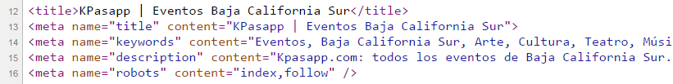
How to use Meta tag?

Slide 7
Does Meta tag help SEO?
Yes, but not all
Title - most important! ~ 55 chars
Keywords - doesn’t make much sense now
Description - quite useful, attract visitor, ~155 chars
Robots - SE crawlers (robots/bots)
index/noindex
follow/nofollow
Notes:
the fact that Baidu’s Chinese-language search engine considers the keywords and description meta tag a major factor in its search algorithm

Slide 8
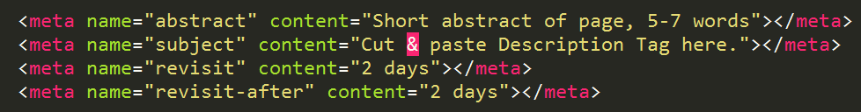
Meta not recommend to use
Title & Description is enough
Google bots is smart, u can’t ask them what to do

Slide 9


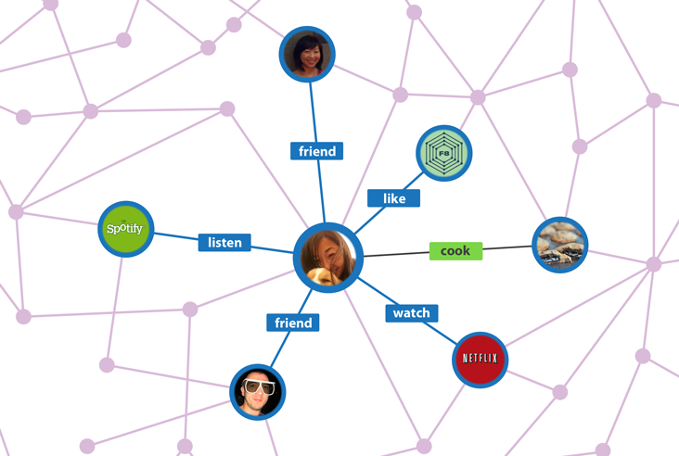
Open Graph Meta
Enables page become a
rich object in a social graph

Slide 10
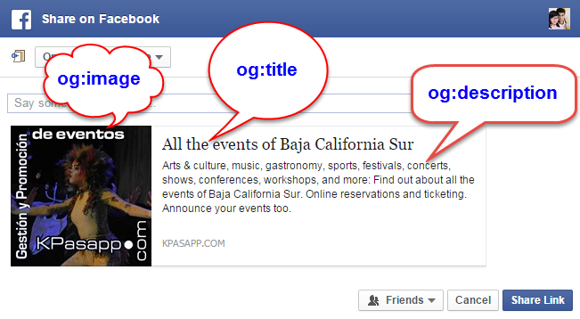
Open Graph Preview

Slide 11
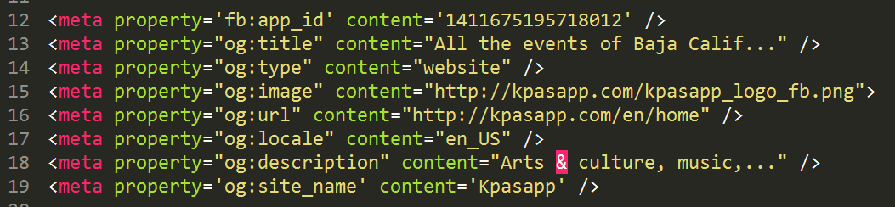
Open Graph, how to?
Required*:
title
type
image
url

Slide 12
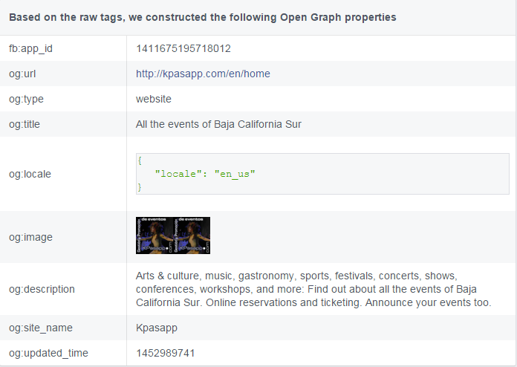
Open Graph, debug, update?
https://developers.facebook.com/tools/debug/
Notes:
https://developers.facebook.com/tools/debug/

Slide 13





Open Graph, result?
Pinterest 60% increase in visits
Pose 5X increase in daily web signup
Foodily 4X increase in new users
Fab.com 50% increase in traffic from FB
Artfinder 60% increase in time spent
https://developers.facebook.com/blog/post/2012/02/15/early-success-stories--timeline-apps-and-open-graph/
Notes:
https://developers.facebook.com/tools/debug/

Slide 14
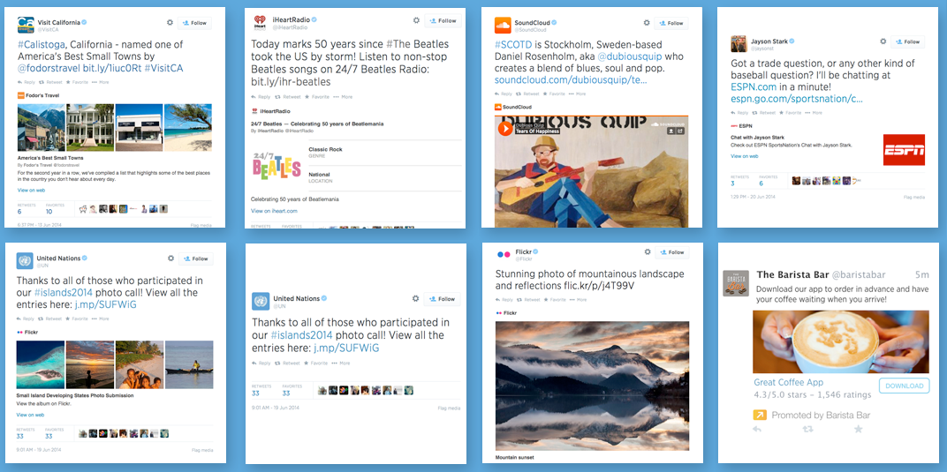
Twitter card overview
Types: Summary, Photo, Gallery, App, Player, Product
Notes:
https://developers.facebook.com/tools/debug/

Slide 15
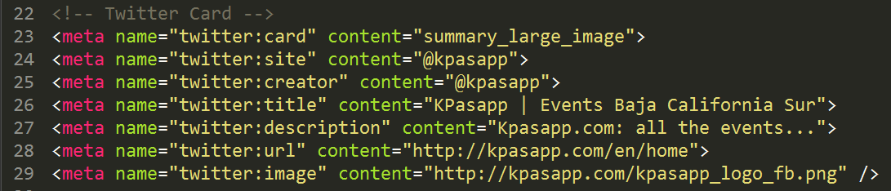
Twitter card, how?
Required*:
card
site
title
description
Notes:
https://developers.facebook.com/tools/debug/

Slide 16
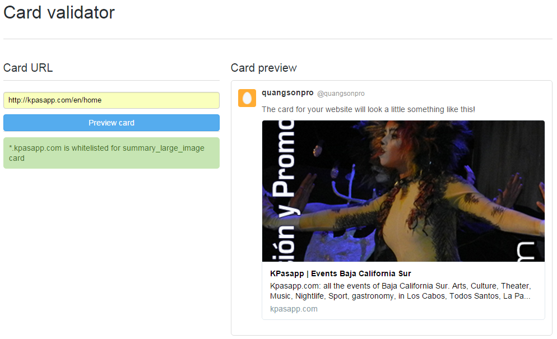
Twitter card, debug?
https://cards-dev.twitter.com/validator
Notes:
https://developers.facebook.com/tools/debug/

Slide 17
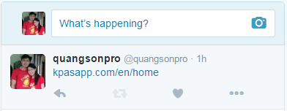
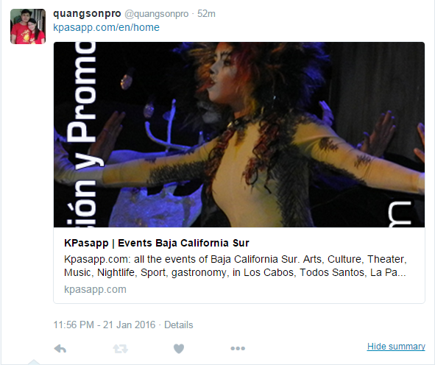
Twitter card, result?
Notes:
https://developers.facebook.com/tools/debug/

Slide 18
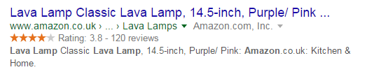
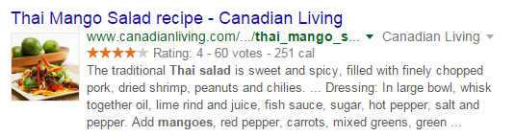
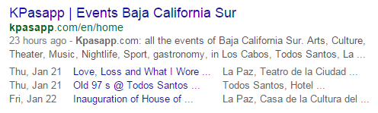
Schema.org, Structured Data
Product
Recipes
Events

Slide 19
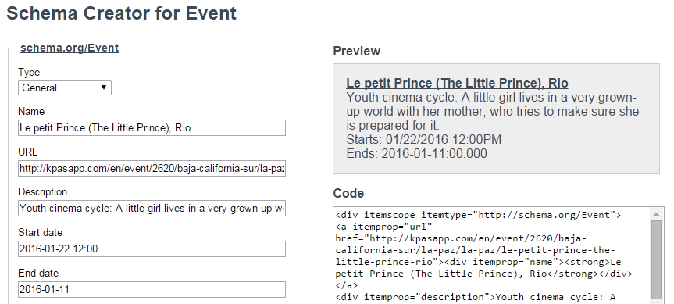
Structured Data, how to?
http://schema-creator.org/event.php

Slide 20
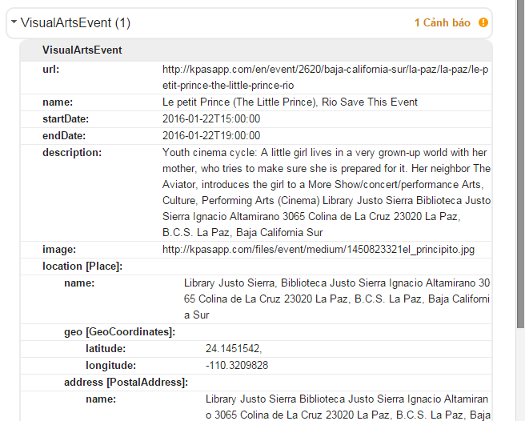
Structured Data, debug?
https://developers.google.com/structured-data/testing-tool/

Slide 21
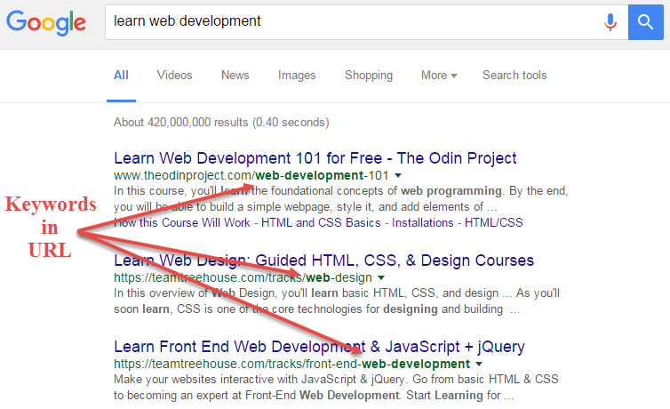
Clean and meaningful URL, why?

Slide 22
Clean and meaningful URL
Puppies confused
http://mydomain.com/puppies-adorably-confused-by-rainbow
http://www.mydomain.com/pub/post?ID=77&kw=puppies+confused
http://cdn07.mydomain.cc/9rf7e2/i?HXID=iaj34089jgt30hgqa3&qry=f#loaddelay

Slide 23
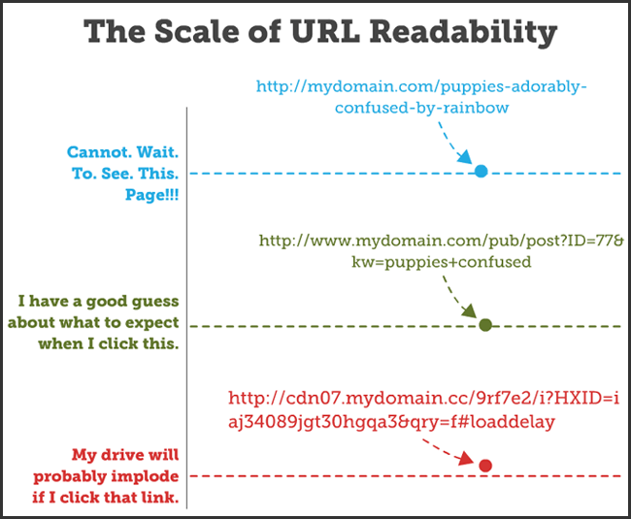
Clean and meaningful URL

Slide 24
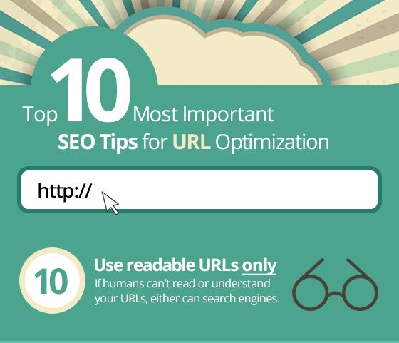
Clean and meaningful URL
Good
www.example.com/topic-name
Bad
www.example.com/?p=578544
Very Bad
www.example.com/shop/
bed-bath/quilts-bedspreads?
id=22748&edge=hybrid&
cm_sp=us_catsplash_bed-%
26-bath-_-row6-_-quilts-%
26-bedspreads
Notes:
http://mysiteauditor.com/blog/top-10-most-important-seo-tips-for-url-optimization/

Slide 25
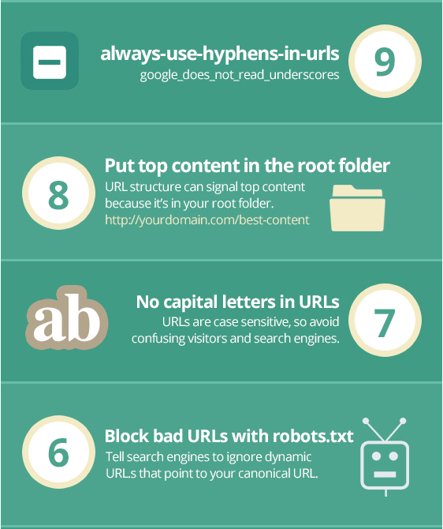
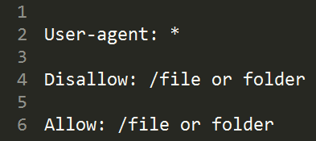
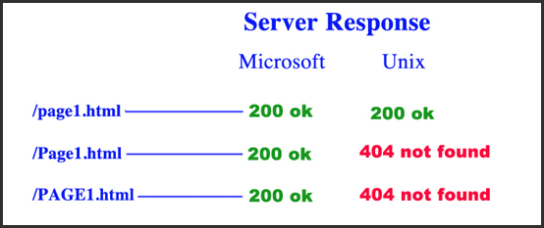
Good
www.example.com/best-content
Bad
www.example.com/sub/Bad_Link

Slide 26
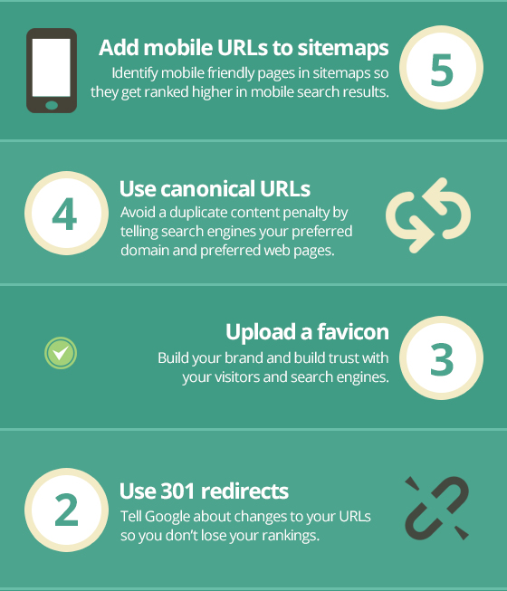

Slide 27
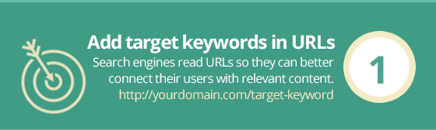
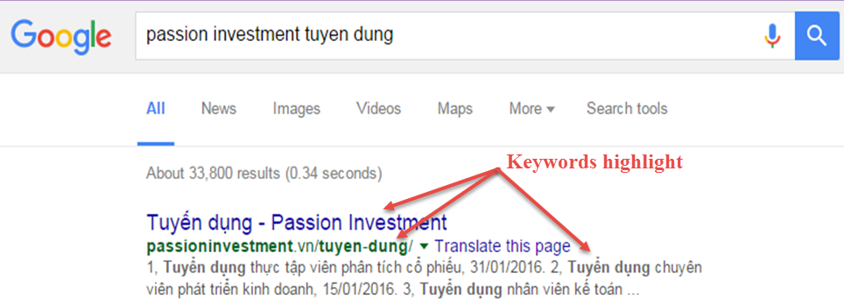
Clean and meaningful URL

Slide 28
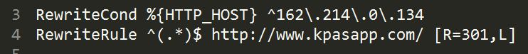
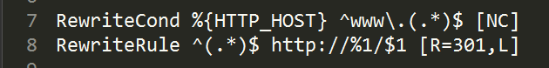
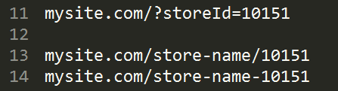
Clean URL (extra)
IP host and domain
www and non-www domain
Parameter (URL ~ 50 – 60 chars)
Notes:
http://mysiteauditor.com/blog/top-10-most-important-seo-tips-for-url-optimization/

Slide 29
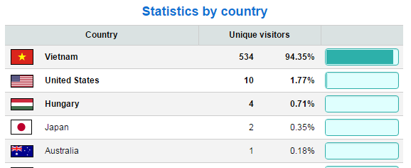
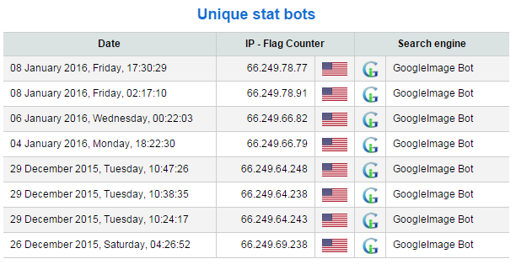
Optimize images

Slide 30
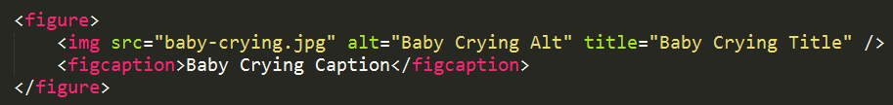

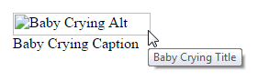
Optimize images
Alt text (important for crawlers), Title, Name, Caption ~16 words
File size
File as small as possible
Resize image before show
Notes:
https://www.searchenginejournal.com/image-alt-text-vs-image-title-whats-the-difference/

Slide 31
Sitemap

Slide 32
Bounce Rate
What is it?
How to fix?

Slide 33
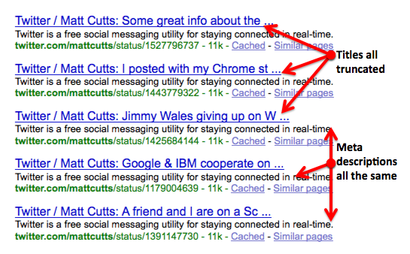
Best practice (MetaTag)
Don’t put too long/short title and meta
Avoid missing/duplicate/non-informative title and meta

Slide 34
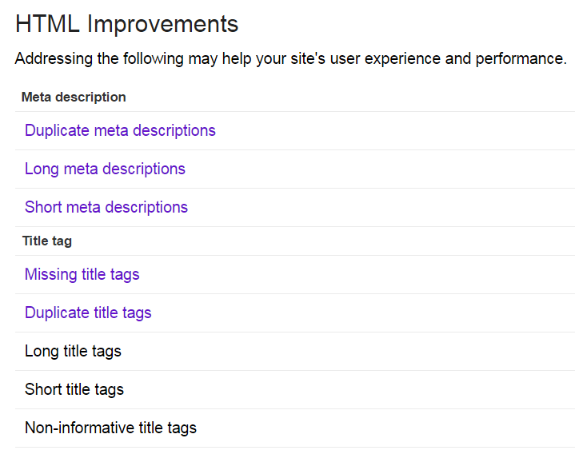

Slide 35
Best practice (MetaTag)
Keyword and description tag aren’t do much, but attract visitor
Robots - Indication to SE crawlers (robots/bots)
index/noindex
follow/nofollow

Slide 36
Tool
Google Webmaster Tool
Structured Data Testing Tool
Facebook Debugger Tool
http://seositecheckup.com/

Slide 37

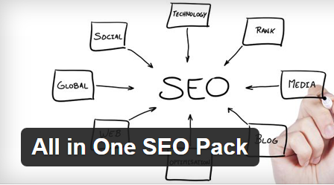
Wordpress (plugin)
Yoast SEO
All in One SEO Pack

Slide 38
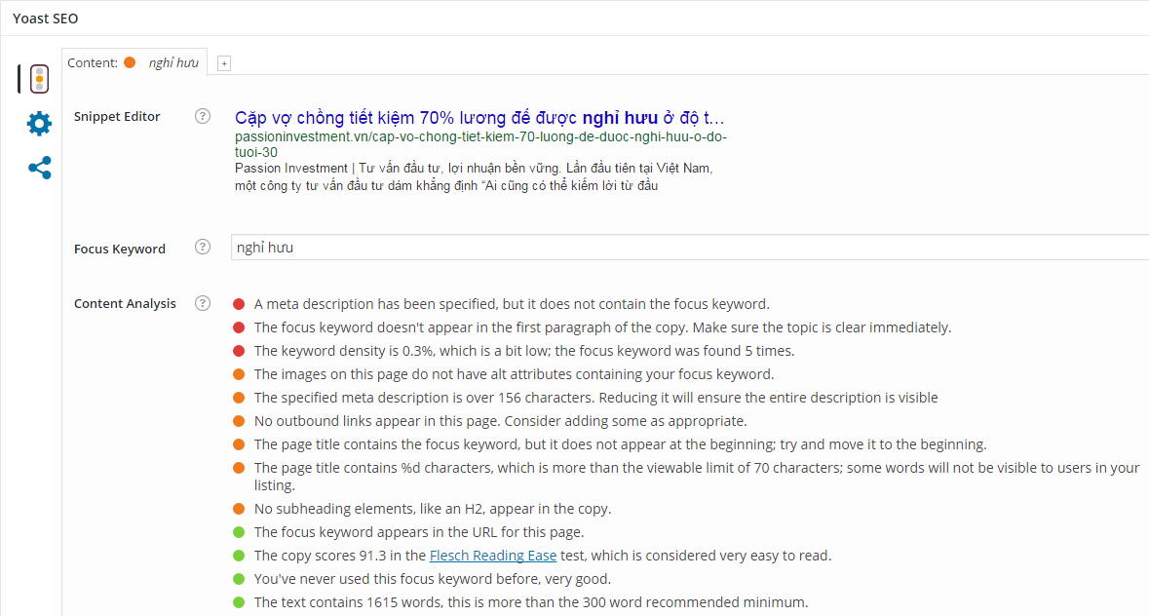

Slide 39
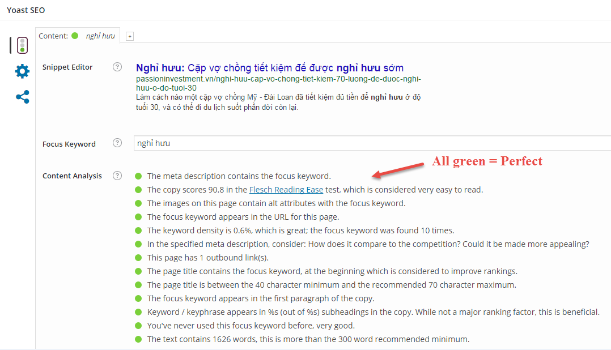

Slide 40
Yoast recommend
Easy to read (11-yr old child), > 300 words, has outbound link
https://readability-score.com/
Title is 40 ~ 70 chars
Keyword density:
URL, Desc, img’s alt, Title at beginning, Subheadings , first <p>, more…
Never used Keyword before

Slide 41
Reference
http://code.lancepollard.com/complete-list-of-html-meta-tags/
http://www.wordstream.com/meta-tags
http://searchengineland.com/figz/wp-content/seloads/2013/10/nofollowtag-1000-2919.png
https://moz.com/learn/seo/meta-description
http://webmasters.stackexchange.com/questions/403/how-should-i-structure-my-urls-for-both-seo-and-localization

Slide 42
Reference (cont)
https://yoast.com/flesch-reading-ease-score/
http://www.cyberalert.com/blog/index.php/the-guide-to-creating-and-optimizing-metadata-for-seo/
http://diythemes.com/thesis/wordpress-seo-image-optimization/
http://backlinko.com/google-ranking-factors
http://www.webmarketingnow.com/tips/meta-tags-uncovered.html

Slide 43
Reference (cont)
http://schema-creator.org/event.php
http://mysiteauditor.com/blog/top-10-most-important-seo-tips-for-url-optimization/
https://www.searchenginejournal.com/five-steps-to-seo-friendly-site-url-structure/
http://www.wordtracker.com/academy/learn-seo/technical-guides/seo-clean-urls
https://moz.com/blog/15-seo-best-practices-for-structuring-urls

Slide 44
Reference (cont)
https://developers.facebook.com/tools/debug/
http://ogp.me/
https://davidwalsh.name/twitter-cards

Slide 45


Slide 46
THANK YOU!

